Slide 1
SAM Activities
AUI project a.y. 2018/2019
By
Leonardo Rossi 893992 leonardo3.rossi@mail.polimi.it
marco minelli 899281 marco2.minelli@mail.polimi.it
samuele langhi 898042 samuele.langhi@mail.polimi.it

Slide 2


Stakeholders and their needs
Patients
Therapists

Slide 3
Stakeholders and their needs
Patients
To be entertained and relaxed during activities
Being able to carry an activity autonomously
To improve visual-motor coordination
To develop tactile perception
To acquire a better spacial awareness
To Avoid any kind of pressure
To Carry out activities in a physical safe environment

Slide 4
Stakeholders and their needs
Therapists
To monitor patients during the activities
to customize the activity based on the specific patients’ conditions
To consult analytics about the different patients sessions
To have activities that can be carried out autonomously by patients without the constant support of the educator

Slide 5
Constraints
Context-related
Room’s limited available space (coarse grained limited movements)
Room’s limited use of bubble machine
Limited use of soap products due to slippery risk
User-related
Impossibility of using frequent cold light changes
Limited scene’s level of graphic details
Limited number of interactive objects in a scene
Technology-related
Dolphin SAM’s limited hardware reliability
Number of http requests handled by the magic room system

Slide 6
Goals
The system must provide multiple activities with various levels of difficulty for each one.
The system must provide an immersive environment to the patient.
The therapist must be able to customize the activities in order to suite at best the current patient.
The therapist must be able to instantaneously interrupt the activity.
The therapist must be able to monitor patients’ activity during one or more sessions.
The system must help to improve patient’s motor coordination ability.
The system must help to improve patient’s focus ability.

Slide 7
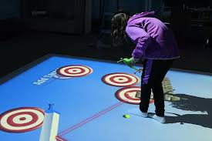
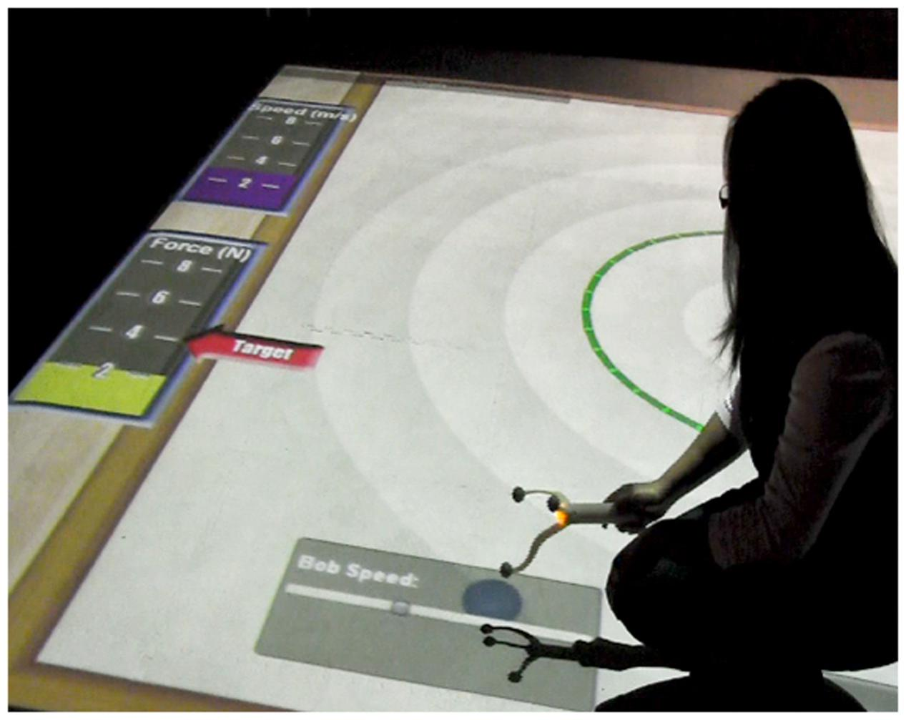
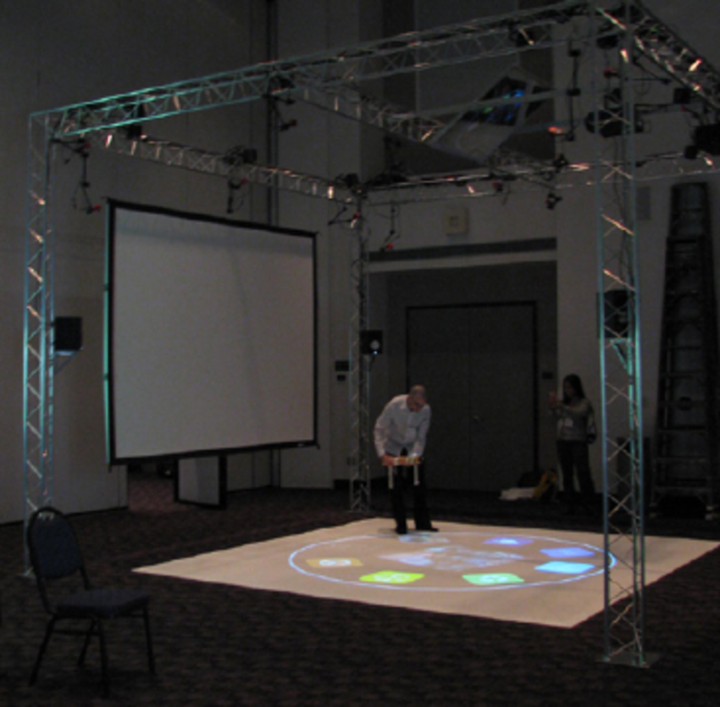
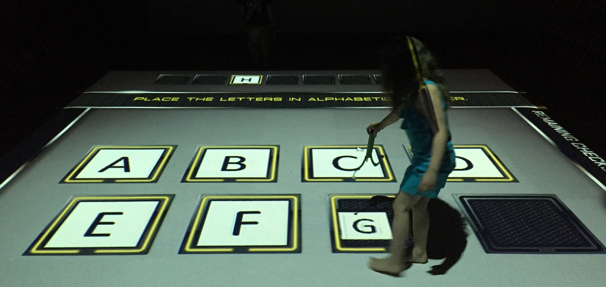
STATE OF THE ART
The smallab case (mixed reality):
Embodiment
Multimodality
composition
“Embodiment, Multimodality, and Composition: Convergent Themes across HCI and Education for Mixed-Reality Learning Environments”
David Birchfield, Harvey Thornburg, M. Colleen Megowan-Romanowicz, Sarah Hatton, Brandon Mechtley, Igor Dolgov and Winslow Burleson

Slide 8
STATE OF THE ART
The mediate case (multisensory enviroment):
Enhance of non repetitive actions
Particle system
Sense of agency with contingent interactions
“Promotion of creative activity in children with severe autism through visuals in an interactive multisensory enviroment”
Narcís Parés, Anna Carreras, Jaume Durany, Jaume Ferrer, Pere Freixa, David Gómez, Orit Kruglanski, Roc Parés, J. Ignasi Ribas, Miquel Soler, Àlex Sanjurjo

Slide 9
State of the art
Other projects:
Rope revolution, a rope-based gaming system for collaborative play
Lands of fog, a full body interaction system, designed to improve social and cognitive skills

Slide 10
DESIGN PROCESS
Goals and needs analysis
Choice of the activities:
One more restricted, focused on precision of the movement
The other with less restriction, more freedom and exploration
Placed in the same virtual environment to show contiguity between them
It was necessary to project a virtual dolphin in order to create a connection between the two worlds

Slide 11
The concept
For the first activity (A), we have come up with a run-game model
Need of precision in the movements
Simple and understandable concept
For the second activity (B), a ”search and find” model Is a good solution
Freedom given to the player
Element of surprise and unknown engage the player in continuing the activity
Both in an underwater environment

Slide 12
Goals
The system must provide multiple activities with various levels of difficulty for each one.
The system must provide an immersive environment to the patient.
The system must put the patient in condition to relax.
The patient must be able to choose autonomously one or more activities suited for his abilities.
The therapist must be able to customize the activities in order to suite at best the current patient.
The therapist must be able to instantaneously interrupt the activity.
The therapist must be able to monitor patients’ activity during one or more sessions.
The system must help to improve patient’s motor coordination ability.
The system must help to improve patient’s focus ability.
The system must create an empathy between patient and the Dolphin SAM smart toy.
The system must provide playful activities in an immersive environment.
The system must limit the physical risks due to the abuse of devices.

Slide 13
Requirements
The system must provide analytics related to the different sessions of activities carried out by a specific patient.
The system must interface with the Magic Room’s devices.
The system must provide an intuitive and accessible interface to patients within the game.
The system must provide an effective and detailed interface for the monitoring of the patients.
The system must enable the therapist to create a profile for him- self/herself and his/her patients.
The system must be able to persist user’s performances and associate them to his/her profile.
The system must provide a summary dashboard of the patient’s game sessions.
The system must provide a protection for user’s personal data (depending on the domain authority).
The patient must not be overstimulated by the activity in order to avoid restlessness and indisposition.
The system must be able to track user’s position data within the Magic Room via the Kinect.
The system must guide the patient during the activity based on the previously chosen difficulty level.
The system must support the parametrization of the activities’ levels in order to let the therapist set the most suitable level of difficulty for a patient.
The system must use Dolphin SAM as an input interface (accelerom- eter, gyroscope, touch sensors, RFID reader).
The system must use Dolphin SAM’s lights as an output interface.
The system must use the Magic Room’s appliances as an output interface (smart lights, projectors, bubble machine).

Slide 14
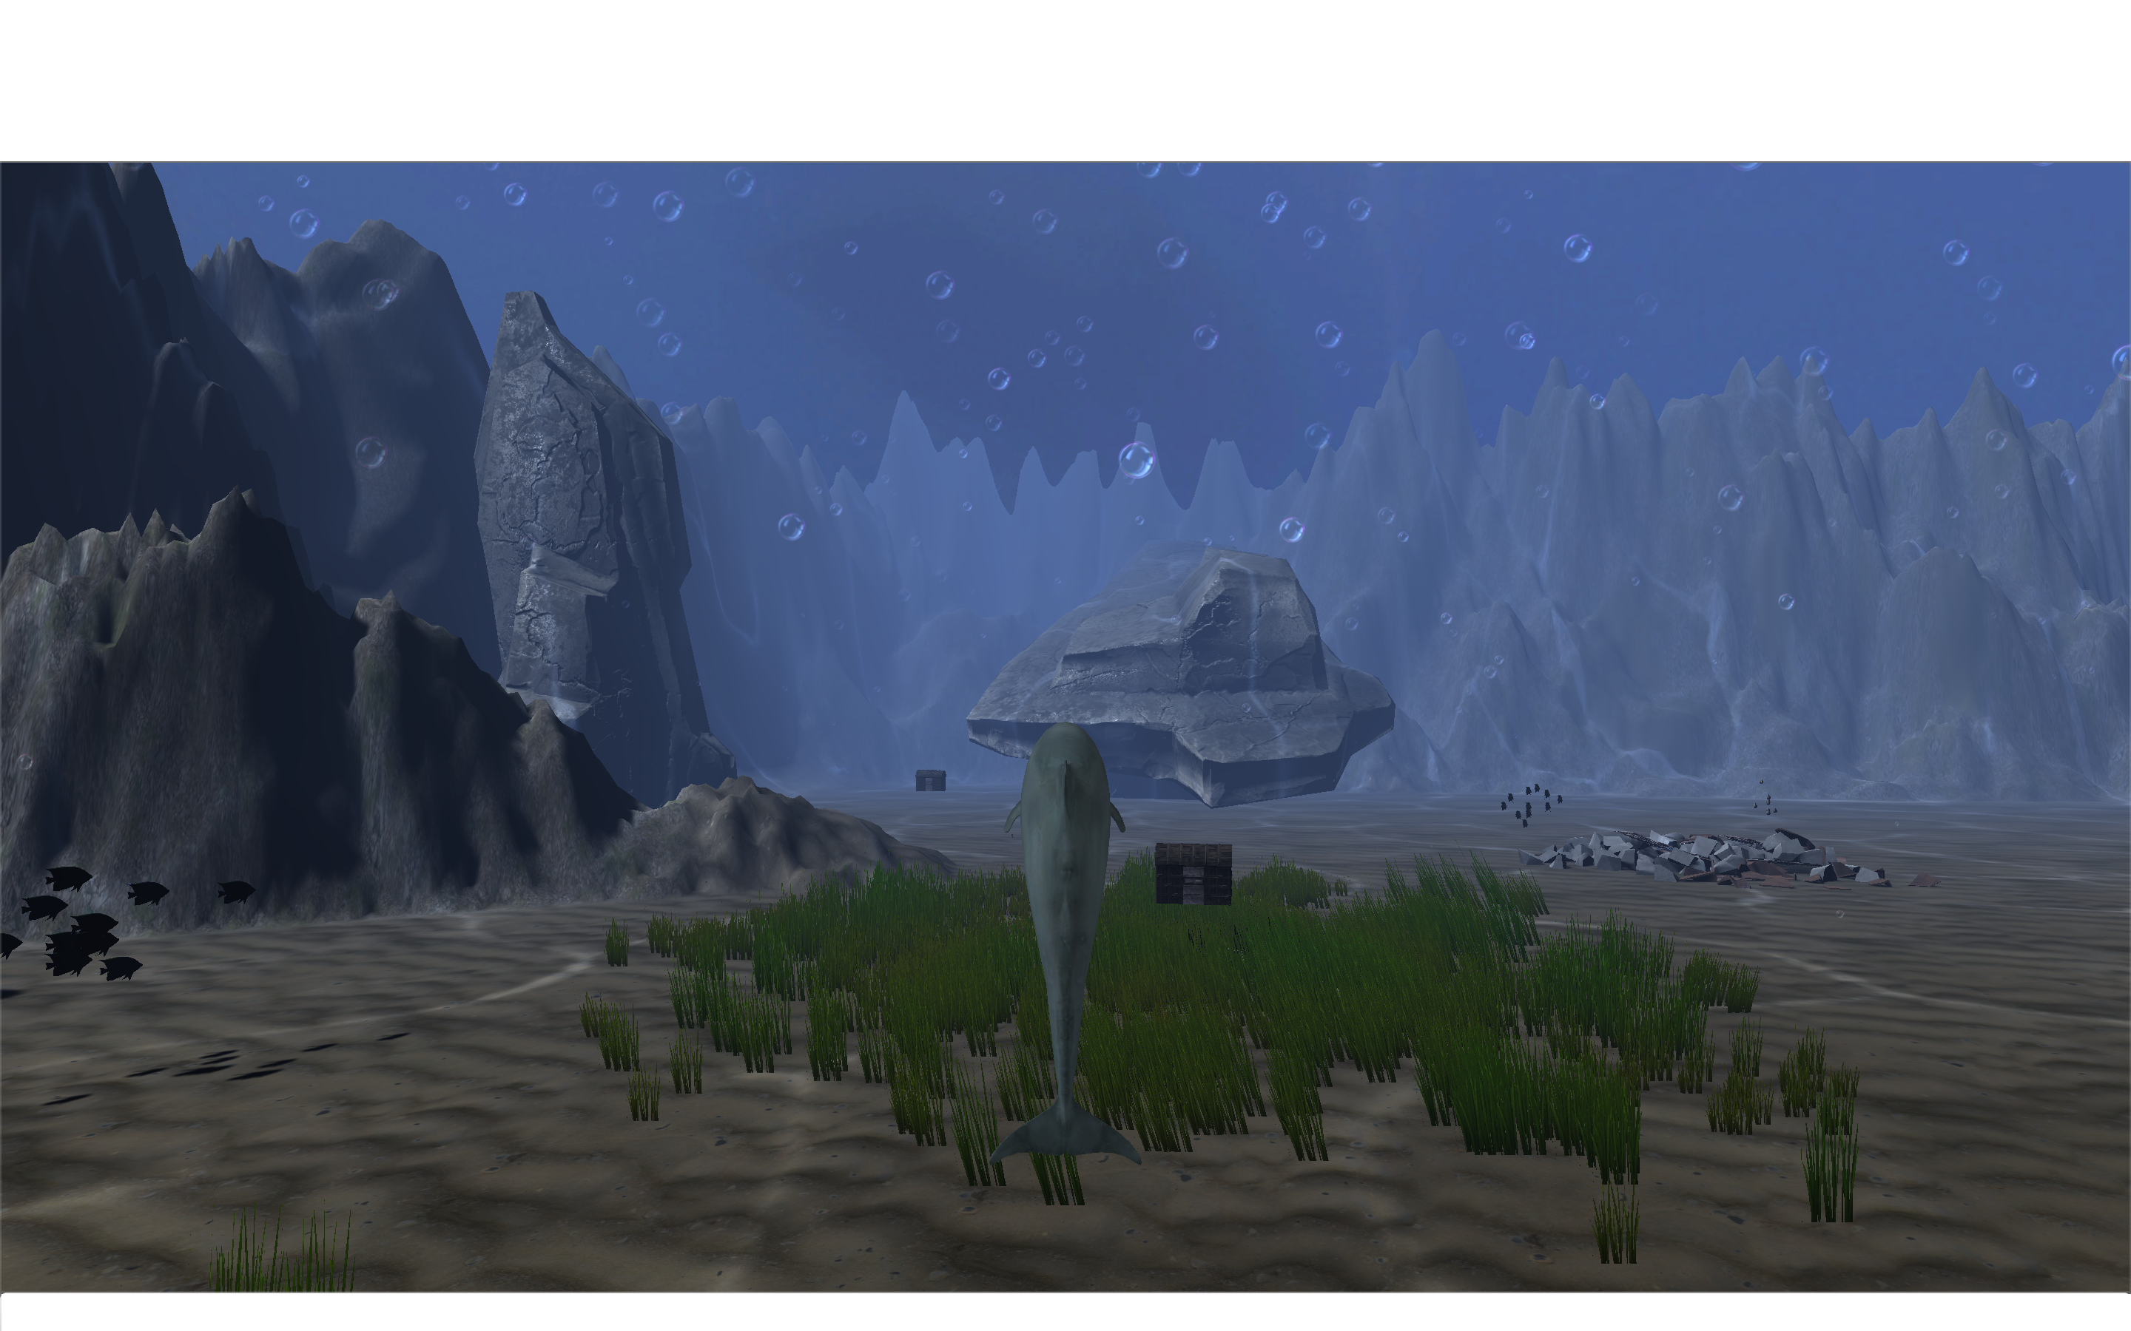
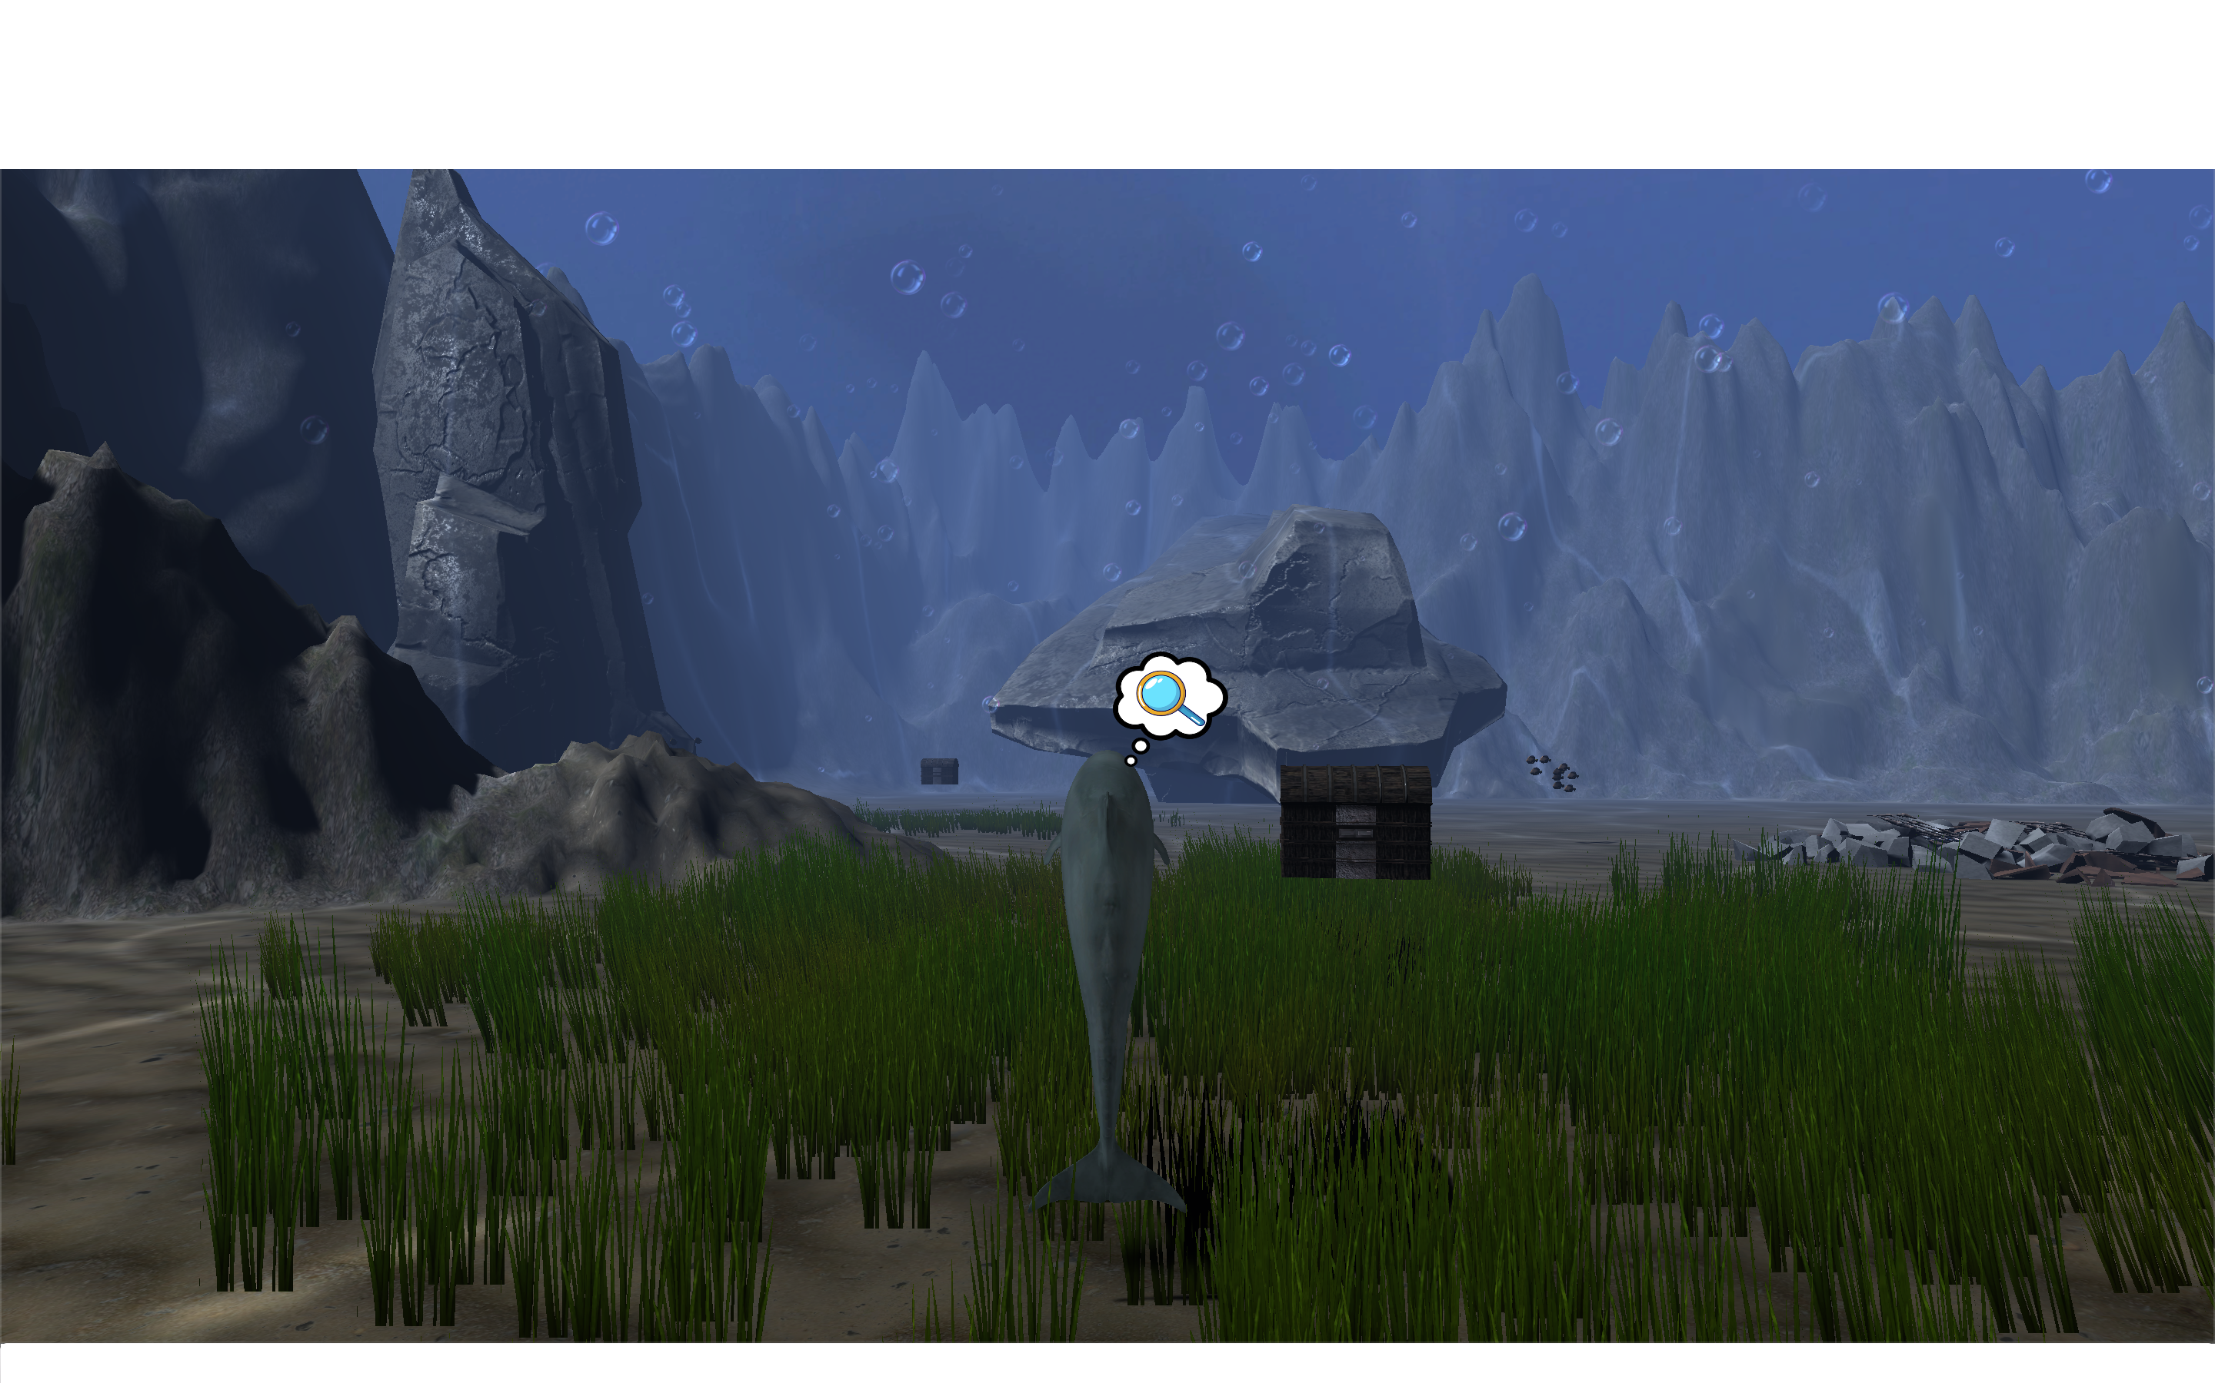
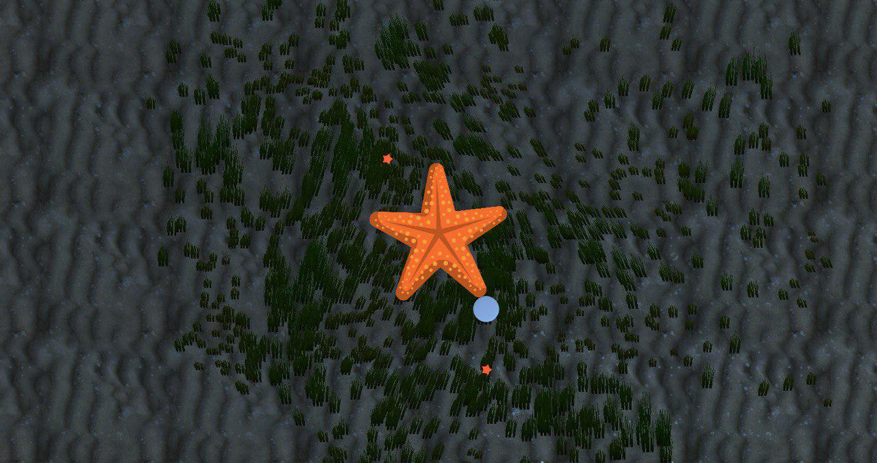
DOLPHIN SEARCH
USER MOVES AROUND USING THE DOLPHIN
COLLECTS HIDDEN OBJECTS IN COLLECTABLE AREA
PHYSICAL SEARCH OF THE COLLECTABLE ON THE GROUND USING THE DOLPHIN
GAME COMPLETED WHEN EVERY OBJECT IS FOUND

Slide 15
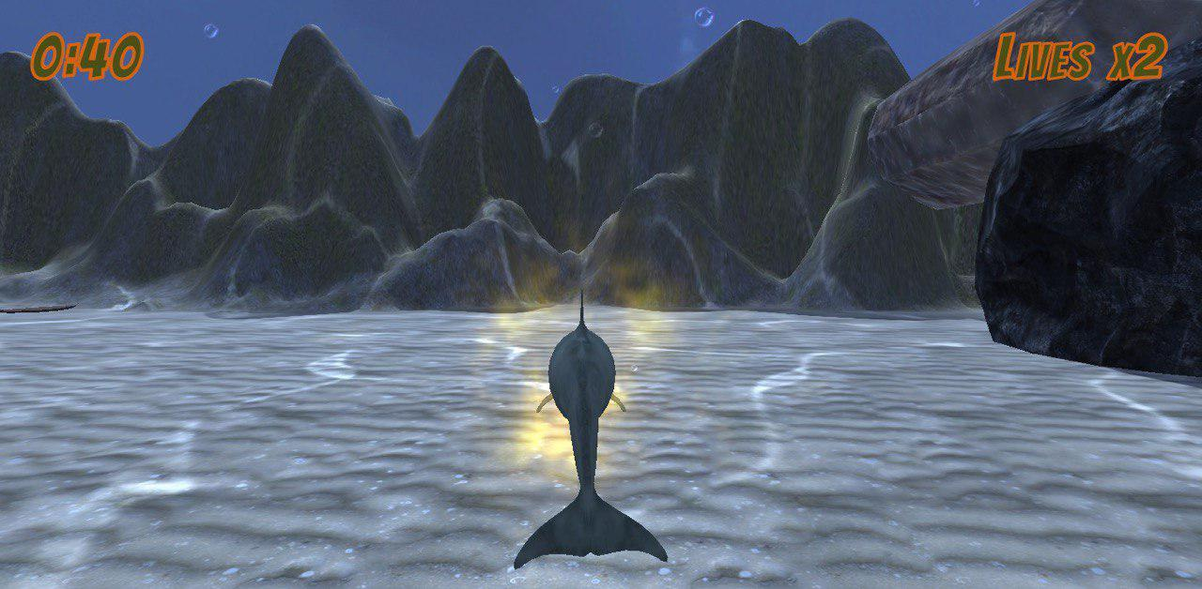
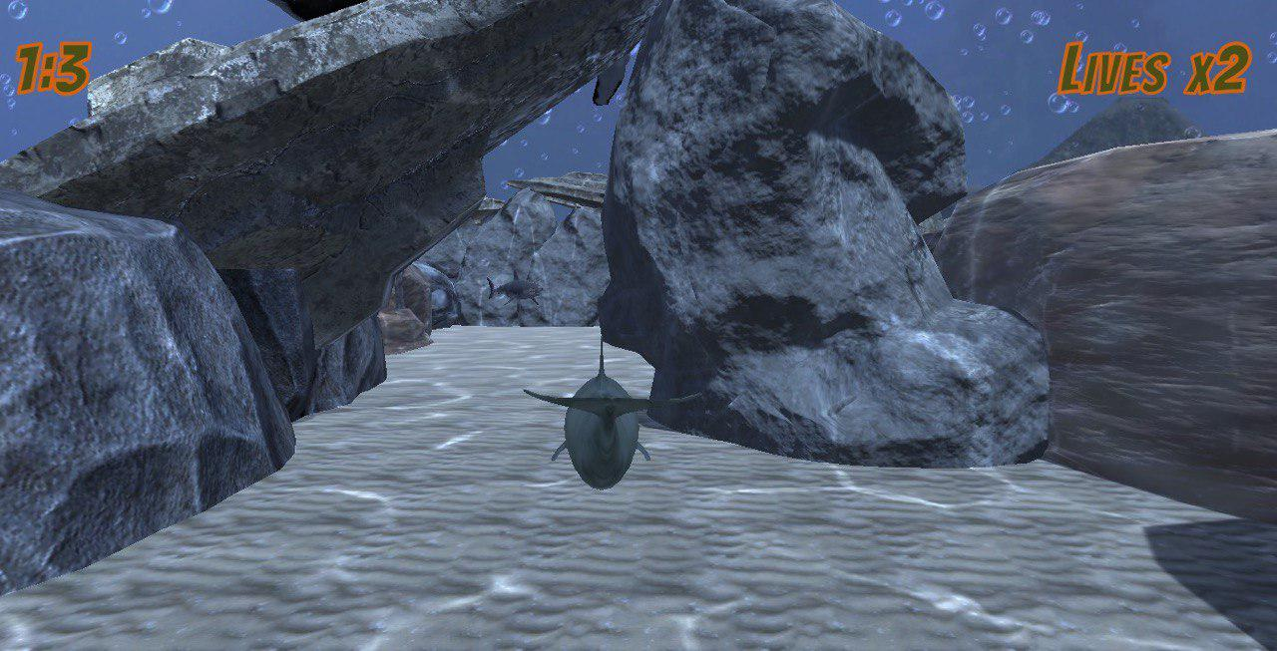
Dolphin RUN
DOLPHIN IS USED AS A CONTROLLER
STATIC AND DYNAMIC OBSTACLES THAT CAN BE PARAMETRIZED BY THE THERAPIST
GAME FINISH WHEN THE PLAYER AVOIDS ALL THE OBSTACLES AND REACH THE FINAL LINE

Slide 16
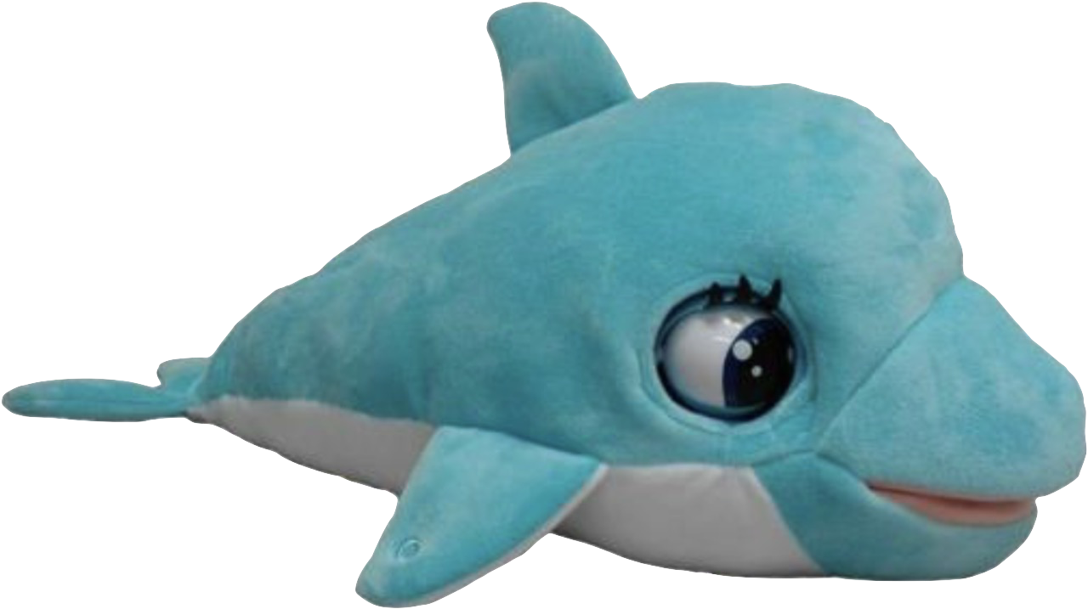
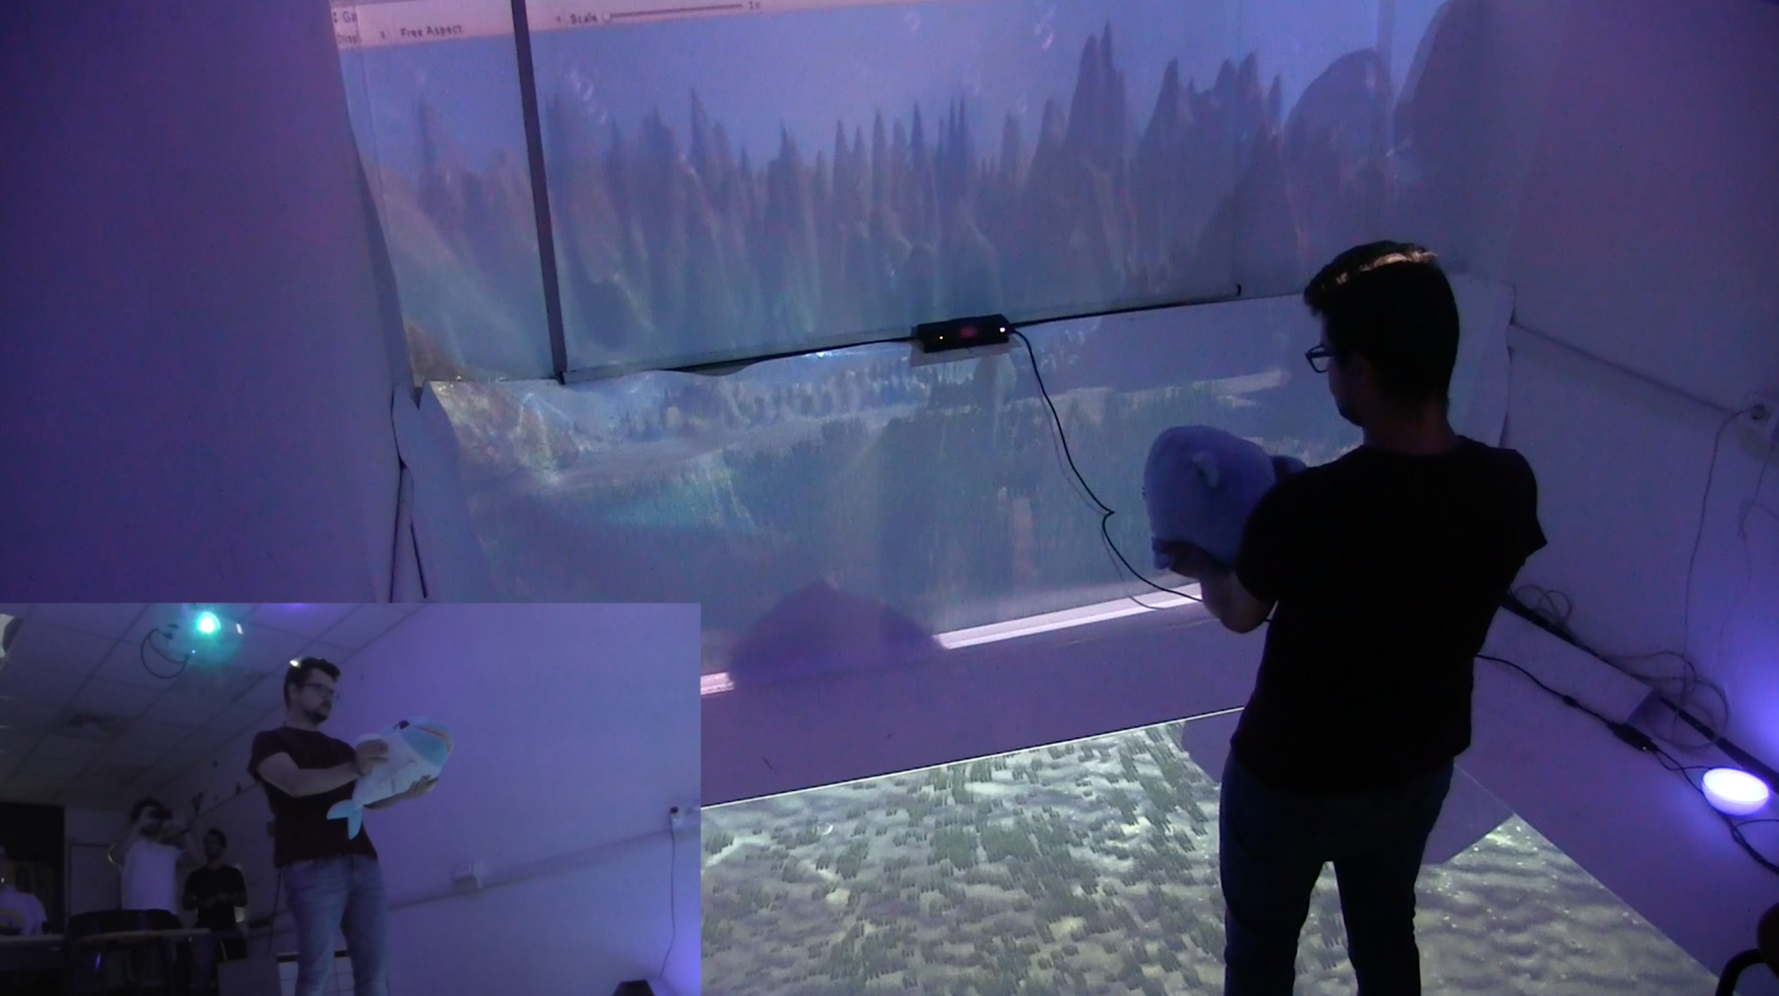
MAIN DEVICES
DOLPHIN SAM MAGIC ROOM

Slide 17

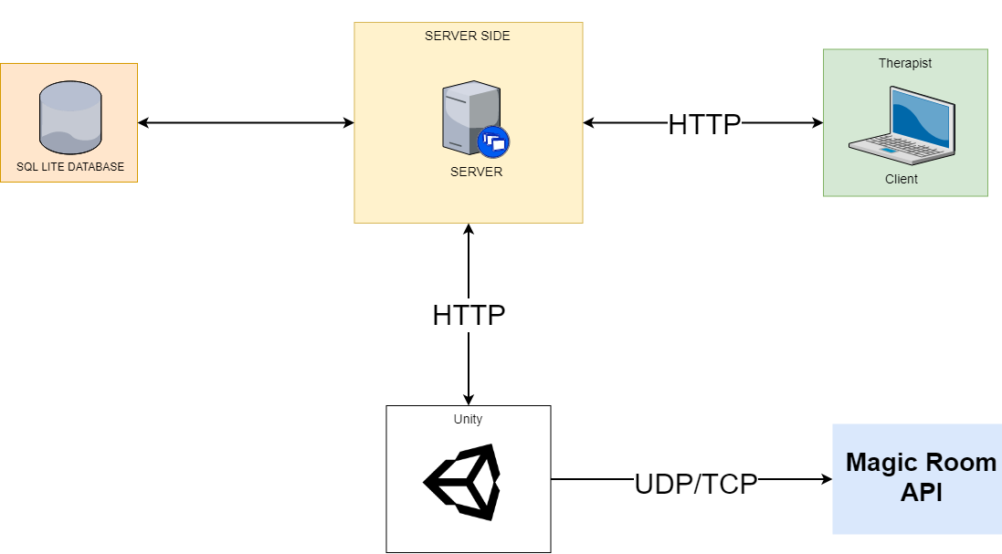
Hw and sw architectures
HW ARCHITECTURE SW ARCHITECTURE
- Model
- VIEW
- CONTROLLER

Slide 18
VALUE PROPOSITION
IMMERSIVE ENVIRONMENT:
help TO IMPROVE PATIENT’S ABILITY TO FOCUS
Interaction with the dolphin:
help TO IMPROVE VISual-MOTOR coordination and tactile perception
APpLICATION EXTENDIBILITY:
Levels Structure and parameters GATHERING can be easily extendible

Slide 19
FUTURE WORKS
SESSION ANALYTICS IMPROVEMENTS:
introduce more specific session’s parameters and use data analysis techniques
Activities improvements:
add new and more personalized levels. Create more activities
Development improvement
deploy the server VIrTUAL containers to wrap-up the software.
UX IMPROVEMENTS

